Slide 1
CircuitVoyager Pre 1
By Joel Schaller
Notes:
Welcome

Slide 2
Table of contents
01
02
03
04
Demonstration
Hardware
Introduction to the DMM
Extension PCB: ideas, problems and possible solutions
Software
Conclusion
Microcontroller, embedded SW and UI for PC in Python
What I’ve learned and further improvements
DMM = Digital Multimeter | PCB = Printed Circuit Board | SW = Software | UI = User Interface

Slide 3
01
Demonstration
Introduction to the DMM
DMM = Digital Multimeter
Notes:
Say what the project was supposed to do and demonstrate what it does at the moment.
Connect to PC
Voltage, current measurement, power display
Ranges
Overload

Slide 4
02
Hardware
Extension PCB: ideas, problems and possible solutions
PCB = Printed Circuit Board

Slide 5
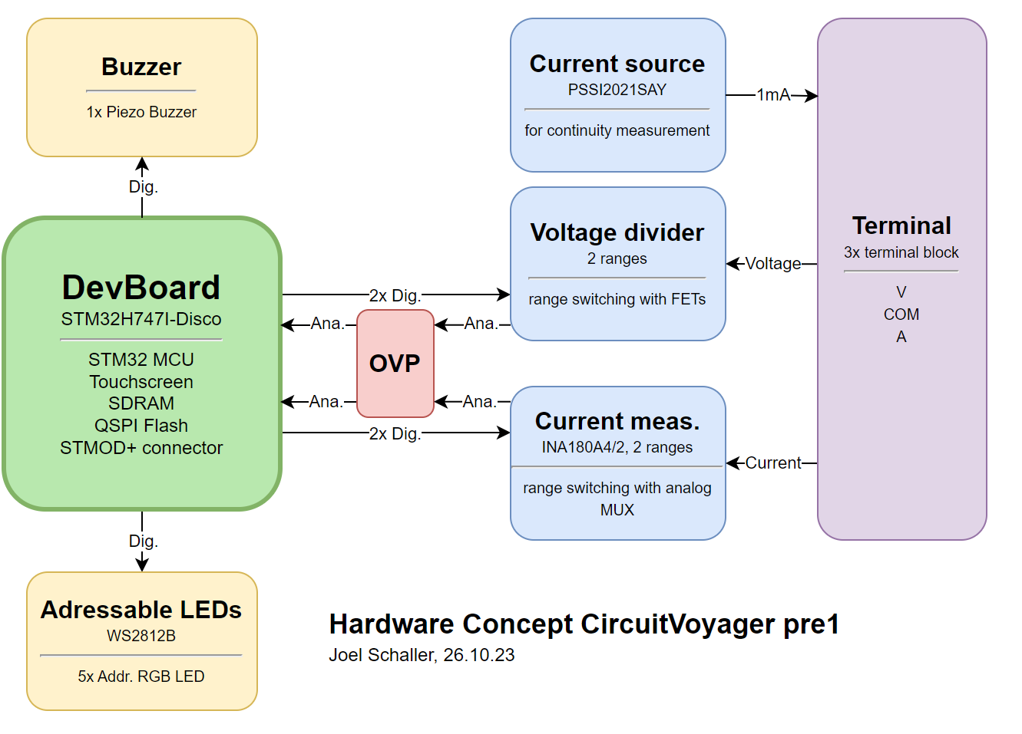
Notes:
Schematic flow is from right to left, instead of from left to right
Show shortly

Slide 6
Notes:
Schematic flow is from right to left, instead of from left to right
You can see buzzer and led part.

Slide 7
Notes:
Explain current measuring circuit.
OVP
Ranges (OLs)
MUX

Slide 8
Notes:
Voltage measuring circuit axplain
Short part about continuity and the current source fail
Cicuit cant amplify but only dampen

Slide 9
03
Software
Microcontroller, embedded SW and UI for PC in Python
SW = Software | UI = User Interface

Slide 10
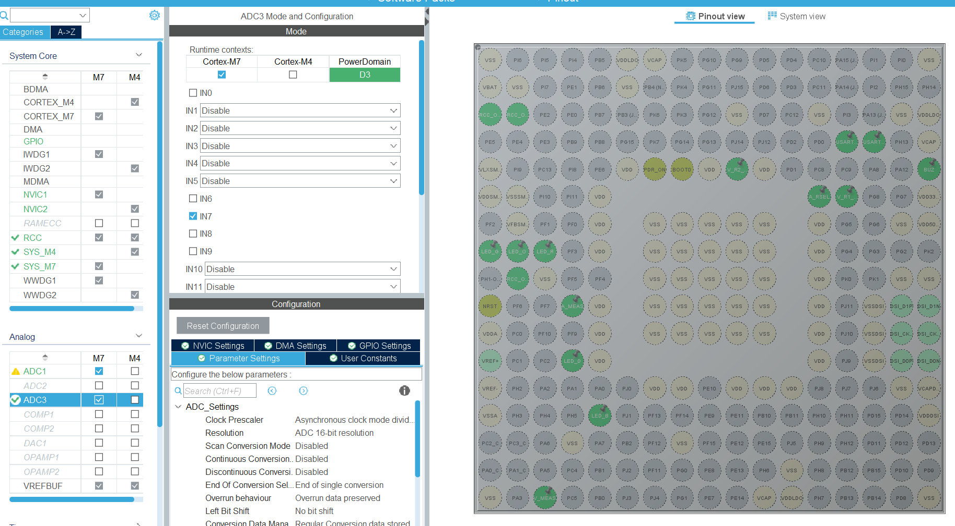
Firmware

Slide 11
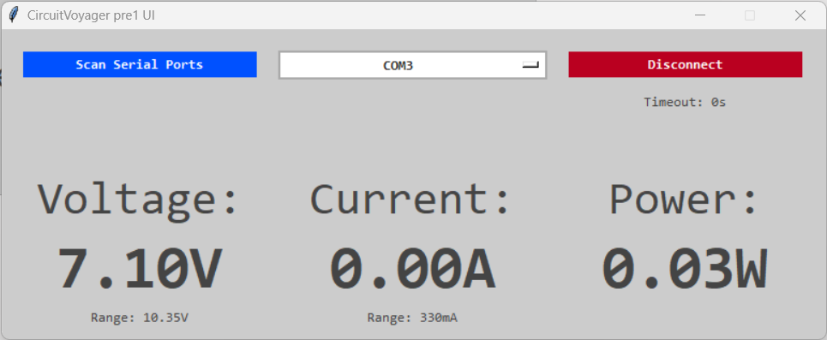

UI - App
UI = User Interface

Slide 12
04
Conclusion
What I’ve learned and further improvements

Slide 13
Conclusion
PROs:
Learned LaTeX
English documentation
Learned about multi core MCUs
CONs:
Pointless HiSpeed MCU
Rail to Rail OP
Current source problem
MCU = Micro Controller Unit | OP = Operational Amplifier
Notes:
I wont move on with the project. First plans to complete til end of apprenticeship

Slide 15
Thanks!

